Slide 1
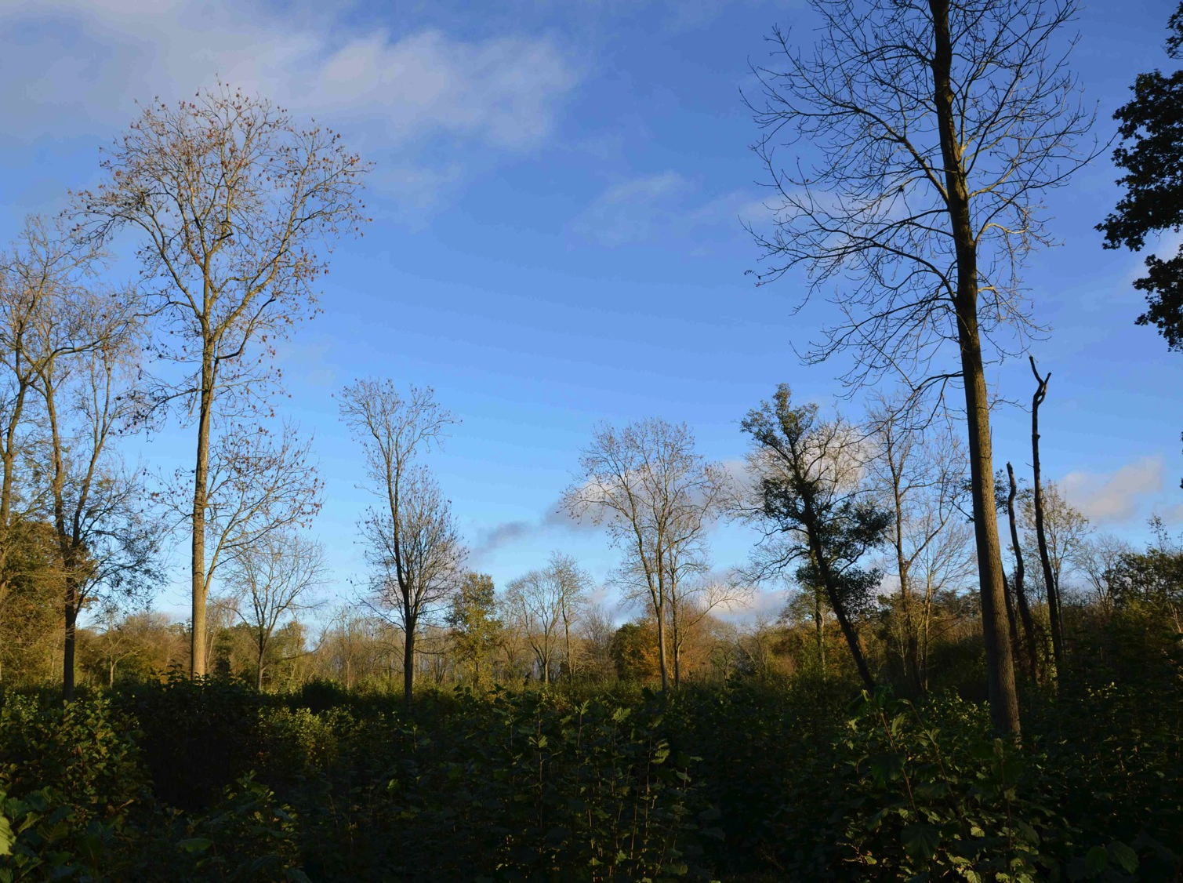
Out of the woods
@danmaclean
dan.maclean@tsl.ac.uk
Notes:
Hi Everyone,
I’d like to start by saying thanks to the organisers, its really great to be here and to be asked to talk about our work on ash dieback and to an audience so interested in these new oportunities for genomics.
I’ve titledt his talk – out of the woods- because as well as taking about progress on the crowdsourced genomics of ash dieback, I’ll be talking a little about how projects that embrace open access data and massive collaboration like crowdsourcing can provide a new model for science in emergencies

Slide 2
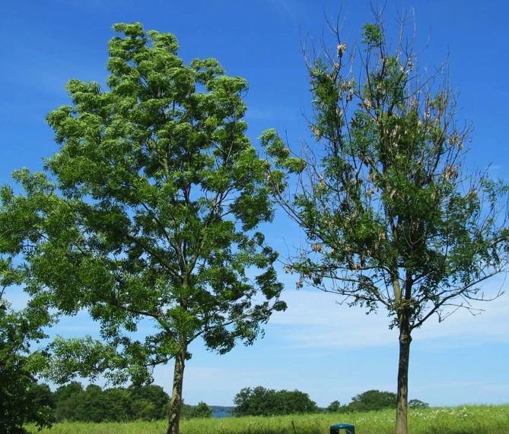
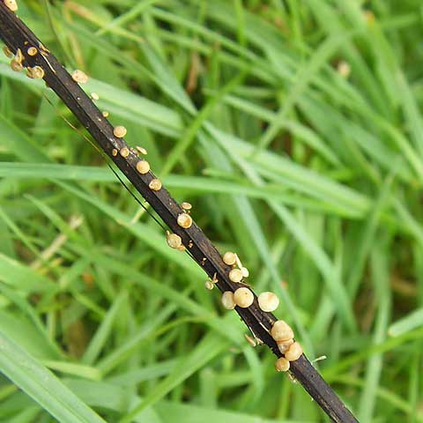
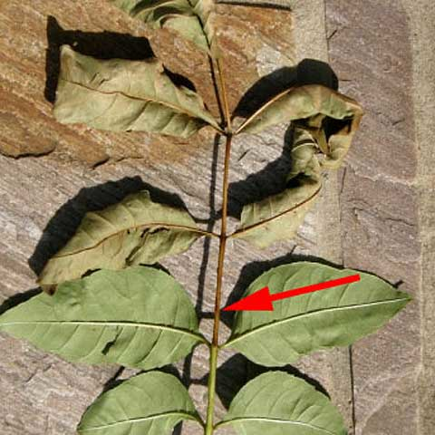
Notes:
Ash, or Fraxinus excelsior, is an important tree and has been so throughout history.
Ecologically Ash is vital, it’s a fast growing tree that crops up quickly in gaps in woodland and can support a massive range of biodiversity.
In the British Isles and Northern Europe it’s a huge figure in norse cosmology “Yggdrasil” the world tree that joins the nine worlds of the mythology is an ash.
Economically it’s important. It has a very straight strong wood and as such is useful in furniture and tools.
Ash lives to about 200 years old although when tended by coppicing practices it can live to be about 1000 years old. There are ash woods in norfolk dating back to the time of the vikings
This is what ash dieback looks like
Two roadside trees, The left tree is still looking unaffected this year whereas the right tree is now severely affected and producing many epicormic shoots, and the disease is even starting to affect the growth and the size of it’s crown.
Ash dieback is clearly noticeable as lesions and cankers on stems and branches, these are visible throughout year.
Throughout summer you can also see leaves with brown leaf stalks.
The causal pathogen makes fruiting bodies on fallen leaf stalks in spring.

Slide 3
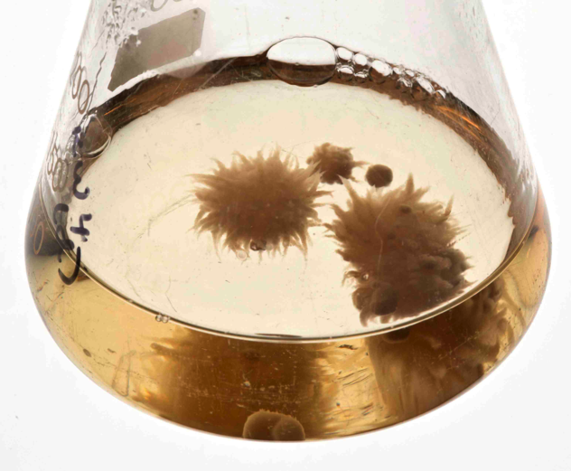
Hymenoscyphus pseudoalbidus
(Chalara fraxinea)
Notes:
The disease is caused by filamentous fungus (teleomorph) Hymenoscyphus pseudoalbidus
Its also called Chalara fraxinea, this is the name of the anamorph stage, lots of people call it chalara
The picutres are taken C. fraxinea growing in liquid media.
Ash dieback disease reached UK in 2012 and had spread across the country in under 12 months
Up to 90% of our 80 million ash trees are under threat
So we have a fast spreading outbreak of this potent pathogen, and as scientists we should be able to do something about it.

Slide 4
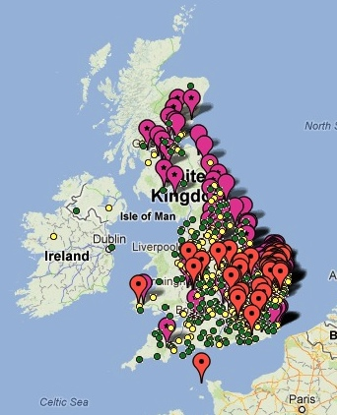
ACROSS THE COUNTRY IN A YEAR
http://ashtag.org
Notes:
Ash dieback disease was first reported in Poland in the early 90s.
The disease spread over continental Europe.
At last, the disease reached UK in 2012
Up to 90% of our 80 million ash trees are under threat
These are data from the ashtag.org site. Ashtag is a smartphone app that allows members of the public to report and photograph suspected
So we have a fast spreading outbreak of this potent pathogen, and as scientists we should be able to do something about it.

Slide 5
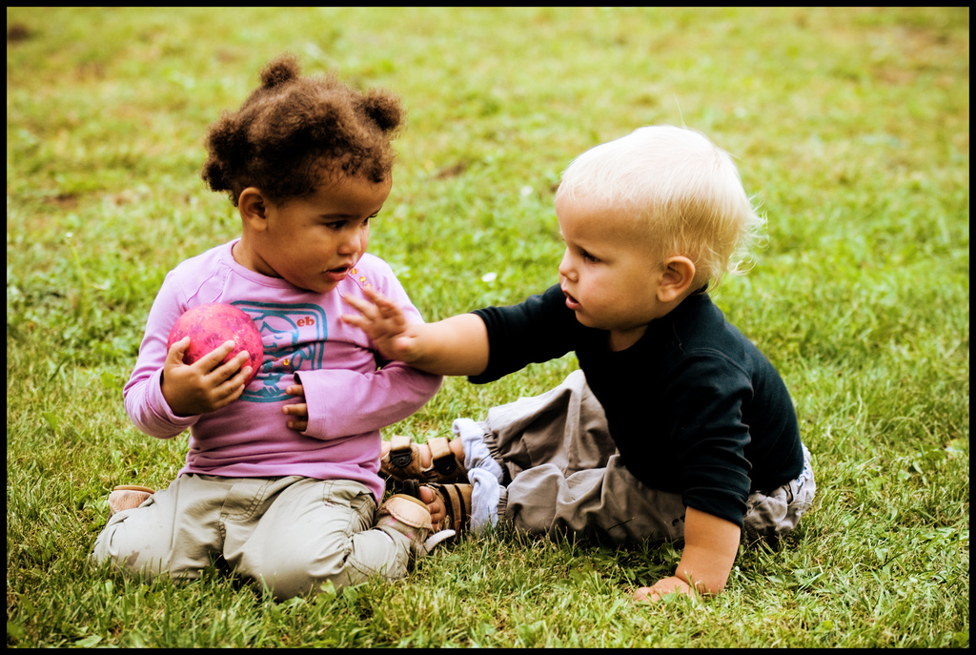
Science is too slow in emergencies
Structure of science inhibits sharing
Duo Penotti by Sabine75 on flickr, licensed under CC-BY 2.0
Notes:
Scientists have always been really bad at responding to a quick change in situations.
the usual business model we have as scientist is inhibitory to a joined up, fast response.
Normally we have to wait for funding of relatively isolated groups on specific projects and then,
because we are relying on high profile publications to get further funding we sit on results
and release data only when we’ve finished our own analyses and are ready to publish.
In situations where speed and collaboration is important this model provides too little, too late.

Slide 6
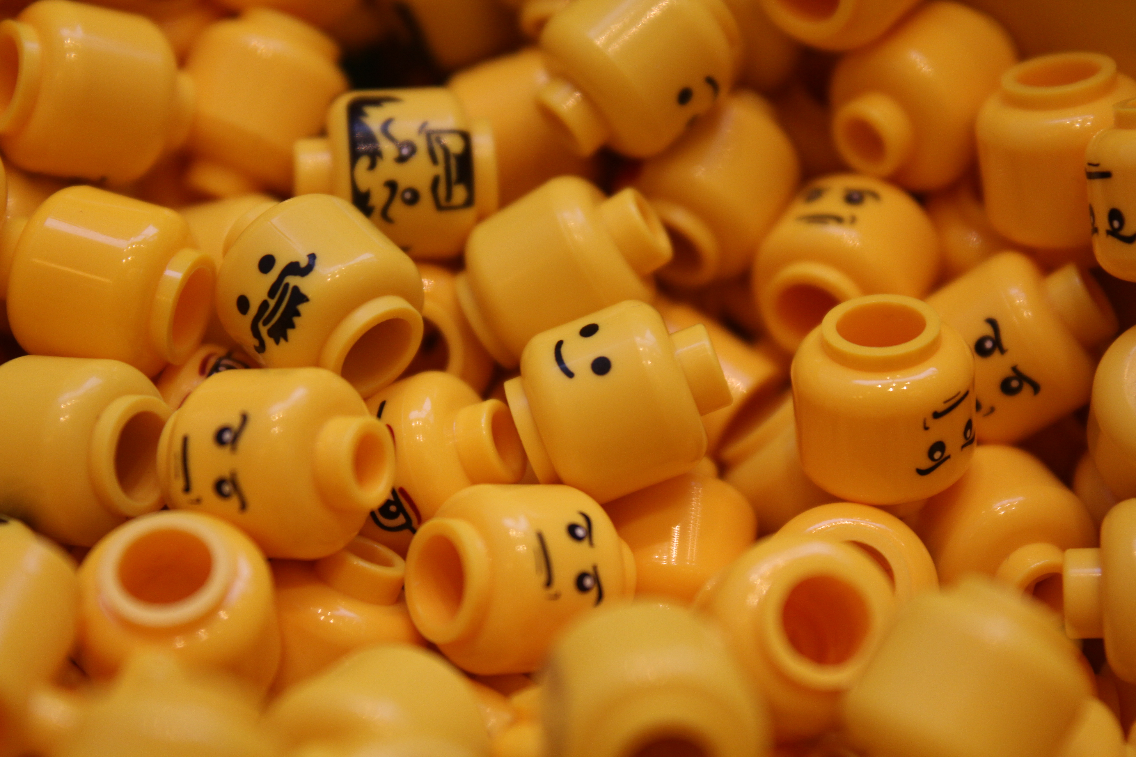
WE NEED NEW MODELS
“two heads are better than one”
Lego faces by Sunny Ripert on flickr, licensed under CC-BY-SA 2.0
Notes:
So we need new models.
And we work with the principal that two is better than one so to try and maximise the speed at which we can respond and to make the most of people and data power, with ash dieback we’ve applied a crowd-sourcing approach.
Crowdsourcing in our project is defined as the process whereby we make whatever data we can generate and can find instantly available, even before it is analysed, and let whoever can help, do what they can. Our initial crowd is scientists,
The practical upshot of this means valuable data gets to many more people who can deal with it much more quickly and more is learned quickly.

Slide 7
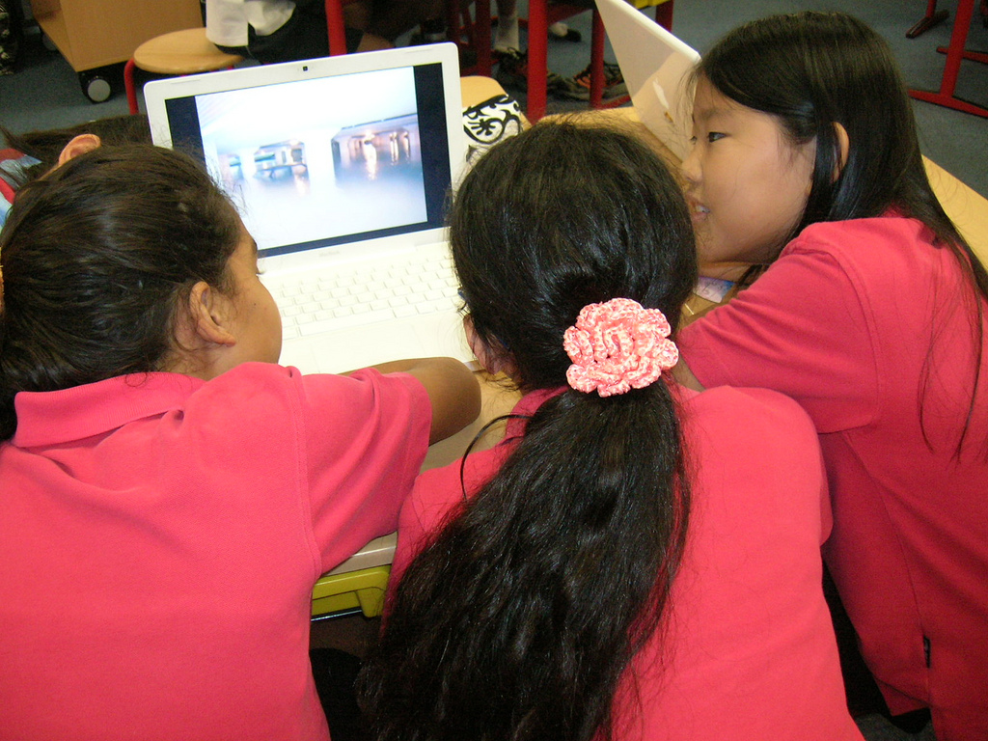
LIVE PEER REVIEW
a global on-line lab meeting
let the experts review the results as they appear – live filtering
PSA Peer Review by Room 202 on flickr, licensed under CC-BY-NC-SA 2.0
Notes:
A great advantage to this is that having a community closely watch the release of data and results as they appear means review and criticism and improvement can happen much more quickly.
Results are examined and filtered in a live peer review process
and with the internet we don’t need the traditional journals as primary data release anymore, so we can turn our way of working on its head and have a publish then filter model, which should allow us to progress much quicker as a community – by removing the incentive for groups to sit on their data until after its published

Slide 8
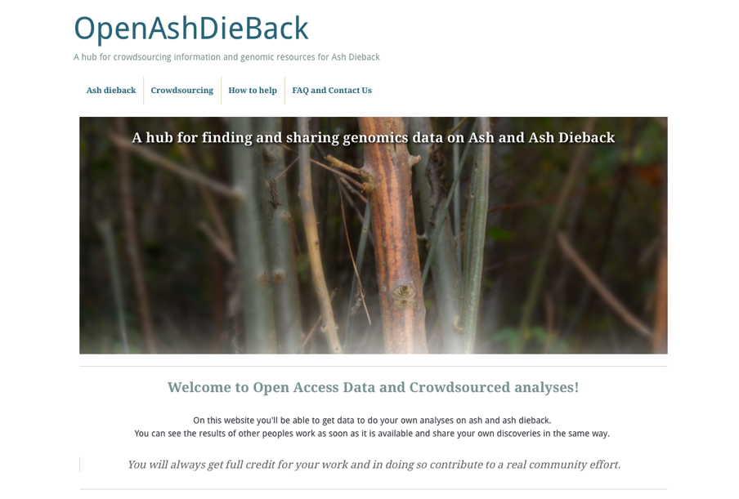
http://oadb.tsl.ac.uk
Notes:
So to embody this and fight back against Ash-dieback, a group of us have come together to bring Open Access data principles to try and fast-forward collaboration on genomics of ash and ash dieback.
We’ve put up a hub website to facilitate this, called OpenAshDieBack. Which is at this URL. This website contains links to our data repo and blog posts describing the analyses and data that people have contributed

Slide 9



ATTRIBUTION OF CONTRIBUTION
Git and GitHub as a versioned database
push
back
pull
data
make change
version management and contribution tracking
Notes:
The data and results themselves are actually hosted externally on the public website, github.
If you’re not familiar with github, it’s a peculiar sort of social networking site
Github is a programmers social coding website. Github is really great at tracking changes to files and keeping records of who made these changes.
The work cycle is really straightforward: you start the day by pulling the latest version of the data from github,
you make the changes/additions/new data that you think are appropriate and push it back.
Github sits in the middle keeping track of what changes were made and who made them.
That’s the key reason for using github, because its critical that we make proper attribution of contribution.
If we’re going to get people to give their time and effort for free, we really need to make sure that we’re giving credit for it.

Slide 10
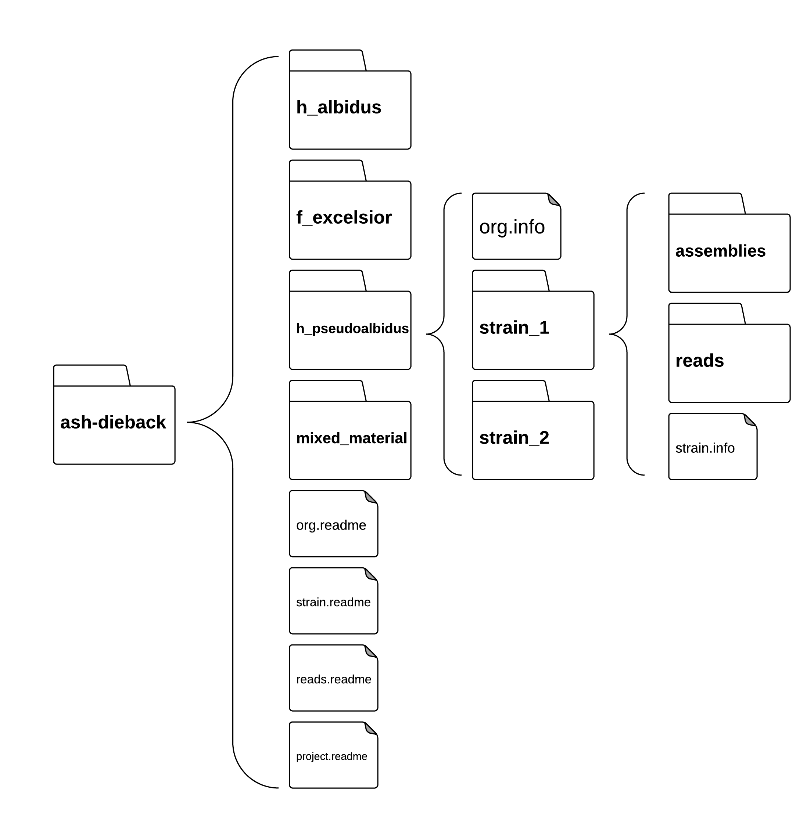
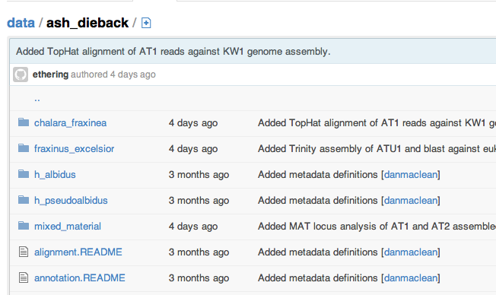
A simple ‘folder’ database
Structure of science inhibits sharing
https://github.com/ash-dieback-crowdsource/data
Notes:
This is the repo itself,
Basically just as directory structure – semantically organized so each dataset and its meta data has a fairly natural place to go.
To find anything its possible to just click through the higher level categories, like species down through strain to the different datasets.
At each level we have these metadata files that explain what is in the folder and how it was generated. It’s a functional, basic just enough sort of database that is good enough to get us going. We don’t ever intend that this is a replacement for databases of record like SRA, we fully expect that all the data in here that can be pushed to the major DB’s will be.

Slide 11
A CALL TO ARMS
GigaScience helped announce our project
doi:10.1186/2047-217X-2-2
Notes:
We announced our project and initial data in GigaScience as commentary, a call of arms to whoever can help.
and more importantly as a promise to anyone helping that they will get the proper credit for the help that they give.
This is key to effective crowdsourcing. People do it because they want to help, they keep doing it if they feel they are getting credit when it is due and are getting recognised by the wider world. If we are going to be able to do this sustainably then we need to start looking at mechanisms to foster new sorts of communities.

Slide 12
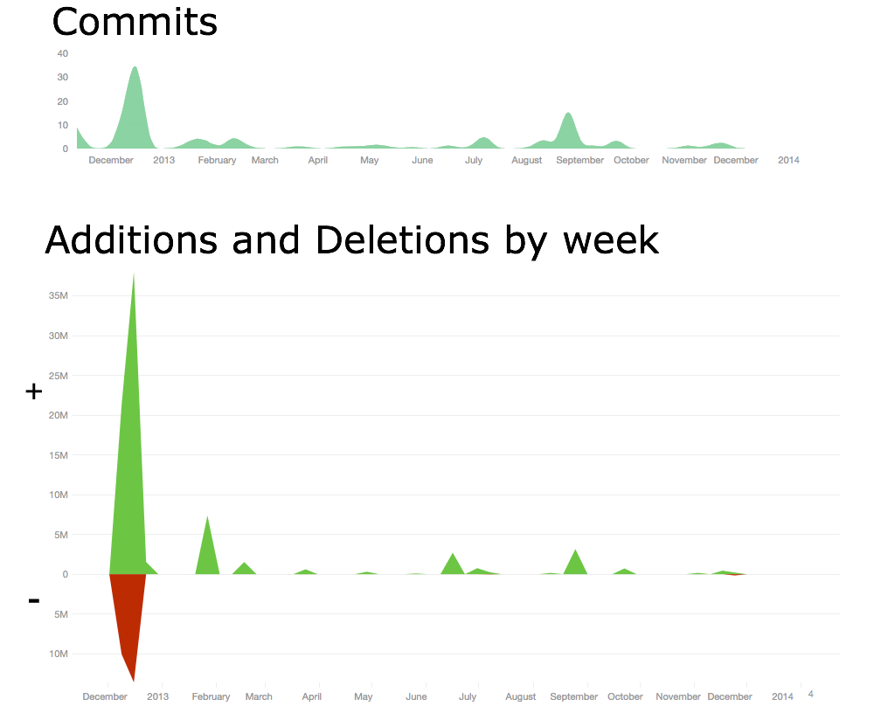
A THRIVING COMMUNITY
Crowdsourcing stimulates involvement
http://dx.doi.org/10.6084/m9.figshare.1005000
Notes:
We had a great start and its continued to draw interest. We stimulated a lot of involvement.
This top figure shows the commits, that is uploads, to the database over the first year. We got over 170 different contributions in this period, from at least 43 members. That’s a good size community from nothing.
The amount of analyses is great too, its quite hard to quantify analysis per se, but a rough guess is the number of lines of stuff added to the database. This peak of additions represents over 35 million new lines added. That figure doesn’t include raw data, raw reads and such, just the derived analysis output.
As you can see we’ve had multiple periods of large contributions over the year which has resulted in 37 separate blog posts about analyses from
So we managed to generate a really significant community in a very short time.

Slide 13
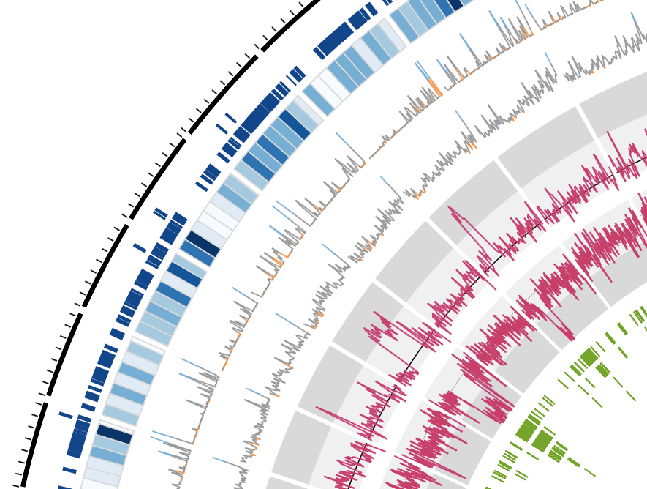
CROWDSOURCING GETS RESULTS
A repeat-rich genome
Bernardo Clavijo,
Manuel Corpas,
Matt Clark,
David Swarbreck
- TGAC
http://dx.doi.org/10.6084/m9.figshare.791640
Notes:
The analyses are going well,
We’ve been able to push quite far through crowdsourcing analyses and are starting to build up quite a good story about our pathogen.
TGAC in Norwich provided us with DNA sequence and a first draft assembly, which is what we see here. Contigs are arranged around the outside of the circle with gene densities in blue.
The green inner track is repeat sequences and the two pink tracks are back aligned read coverage and sequence GC content.
We’ve seen from this assembly that the structure of the genome is very interesting, we get these regions where GC content plummets and coverage and repeat sequence shoots up suggesting that the genome is a non typical reduced pathogen genome in which there are many AT-rich, repeat dense islands scattered throughout.
Together these analyses suggest numerous small collapsed regions in the assembly, an artefact like this can easily be corrected with the inclusion of longer reads

Slide 14
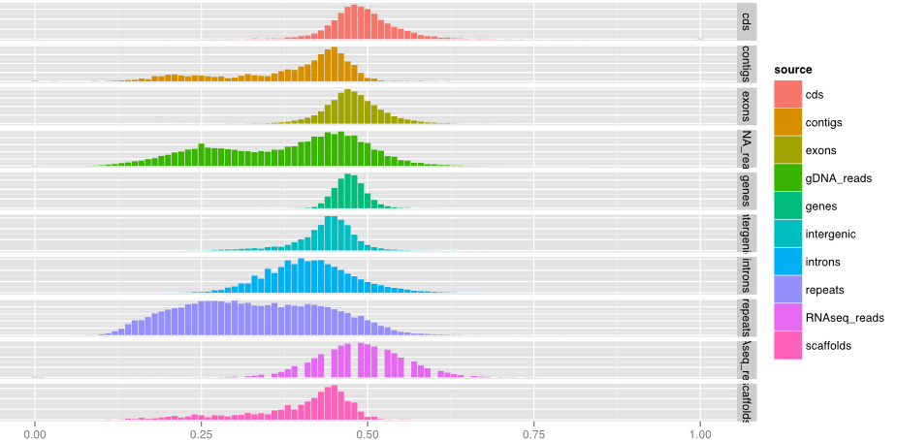
H.pseudoalbidus genome
Genome has AT-rich repeat structure
http://dx.doi.org/10.6084/m9.figshare.706771
Notes:
Finer grained analysis revealed that cod- ing features and Illumina RNA-seq reads are not AT-rich and that this is a property of repeat and intron features.
Together these analyses suggest numerous small collapsed regions in the assembly, an artefact like this can easily be corrected with the inclusion of longer reads

Slide 15
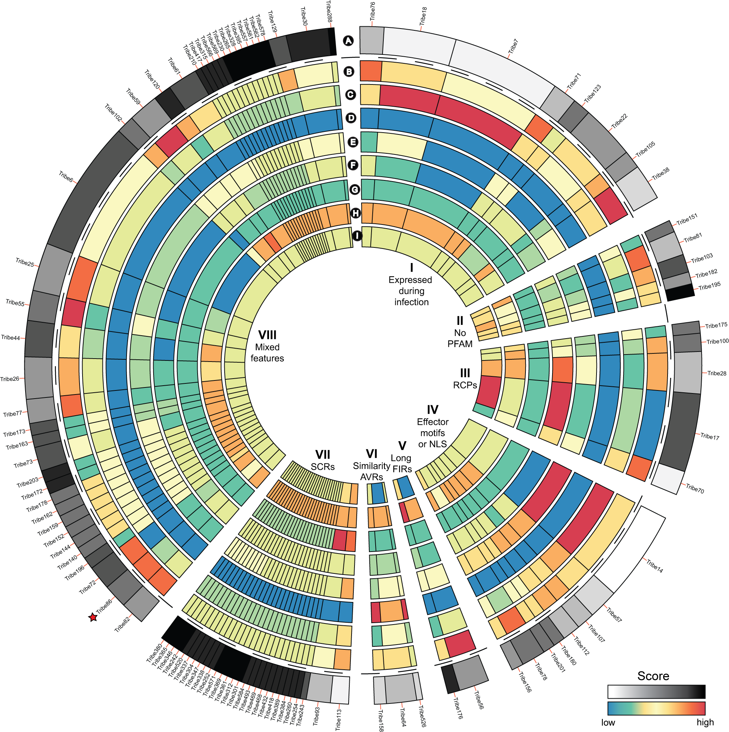
Identifying effector candidates
Diane Saunders
- JIC
http://dx.doi.org/10.6084/m9.figshare.1005005
Notes:
We also examined predicted proteome of H.pseudoalbidus KW1 for potential secreted proteins
We then clustered all proteins based on sequence similarity using OrthoMCL to create these tribes, the groups you see in the diagram, we annotated the protein tribes for known effector protein features, Effectors being the proteins that the pathogen uses to cause disease in the host.
WE see a few common groups like those expressed during infection, those with common effector motifs, etc. And with this we identified a repertoire of effector candidates.

Slide 16
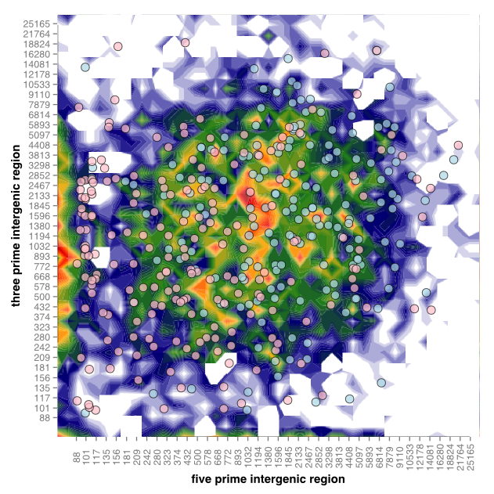
A ONE SPEED GENOME
Diane Saunders
Kentaro Yoshida
http://dx.doi.org/10.6084/m9.figshare.1005006
Notes:
We also got a good look at whether genes encoding secreted proteins are in gene sparse or dense re- gions of the genome.
This figure plots the five prime flanking intergenic region of the gene against the three prime, the colour indicates frequency and the spots are genes red spots indicate genes for the individual secreted proteins.
The pattern we see is indicative of a single speed genome, with genes encoding secreted proteins dispersed evenly throughout a genome that has no obvious gene sparse or gene dense regions. Some very virulent pathogens such as the potato late blight pathogen P.infestans that seem to have very fast evolving effectors keep these in a gene sparse part of the genome that seems to be evolving more quickly and potentially adds to their ability to switch or out compete hosts. We didn’t obserbe this in the

Slide 17
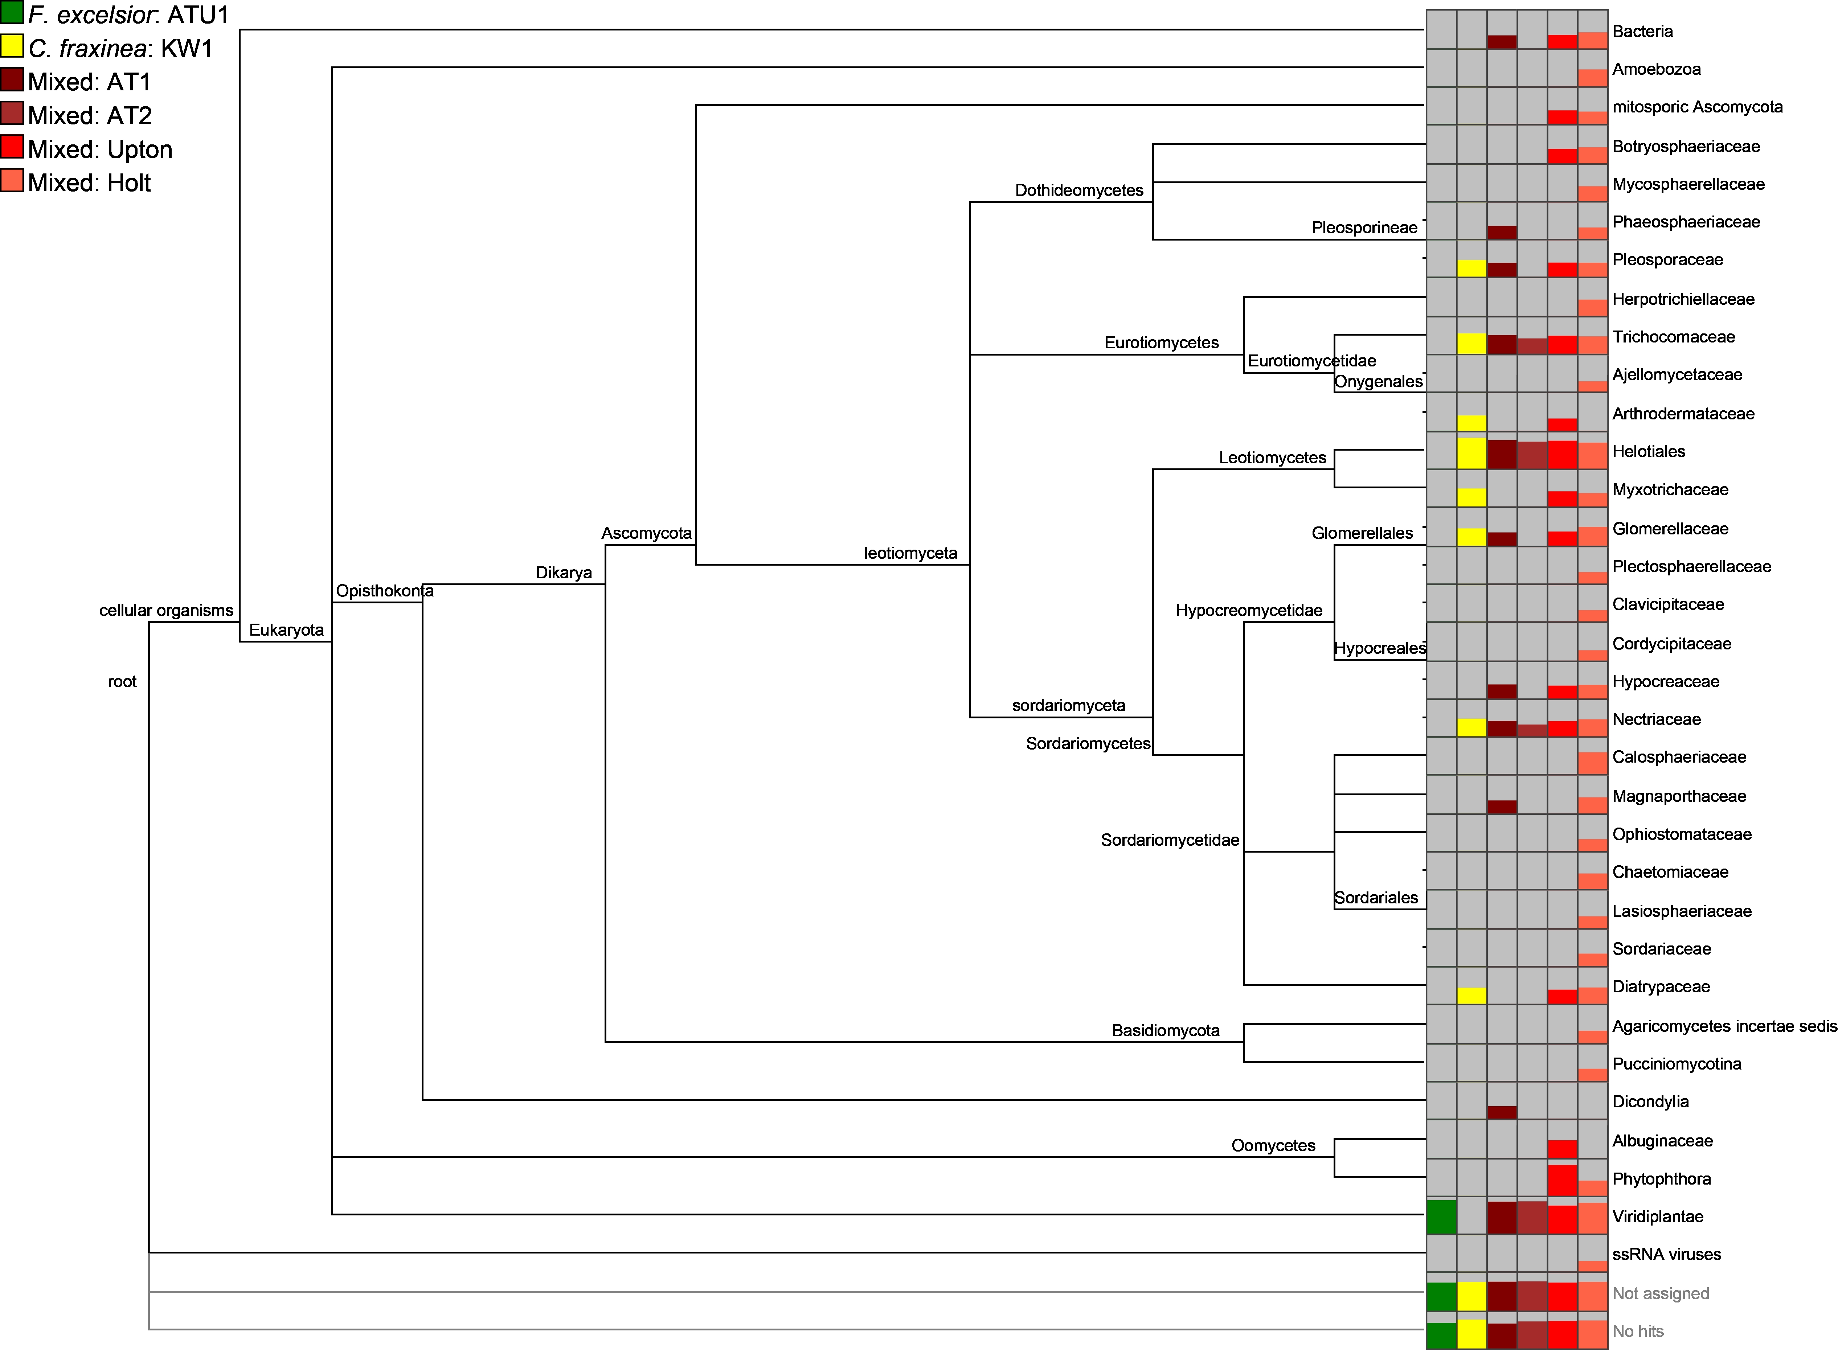
METAGENOMICS
Christine Sambles
David Studholme
- U of Exeter
http://dx.doi.org/10.6084/m9.figshare.807684
Notes:
We’ve also received metagenomic analysis of the mixed material samples on OADB. These showed us the range of organisms potentially co-habiting with the fungus, in particular we noticed Togninia
Species which has been observed in dead vascular tissue of declining ash tree branches in the US.

Slide 18
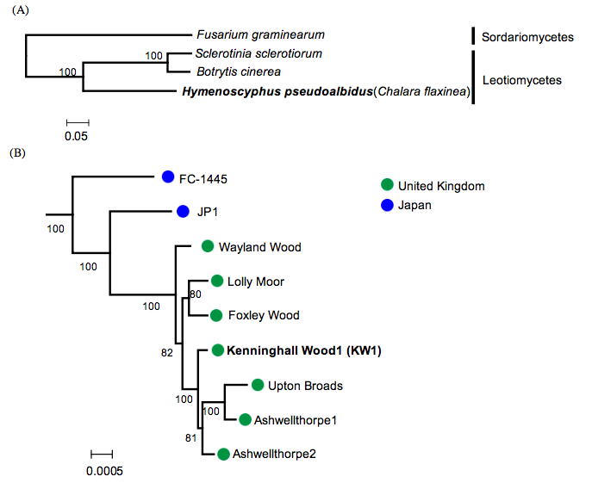
DIVERSITY IN THE UK POPULATION
Kentaro Yoshida
Tsuyoshi Hosoya
http://dx.doi.org/10.6084/m9.figshare.1005007
Notes:
We’ve had quite a few donations of strains from around the UK and the wider world now. We’ve been able to do SNP calls relative to the reference with these and show the diversity between these isolates
Japanese isolates were separated from a single common ancestor of European isolates, suggesting that Japanese isolates might be ancestral, very distantly. The japanese isolates also showed much greater genetic diversity and overall the tests on over 5000 genes suggest that the tested genes are unlikely to have been subjected to positive selection since the separation of the UK and Japanese isolates.

Slide 19
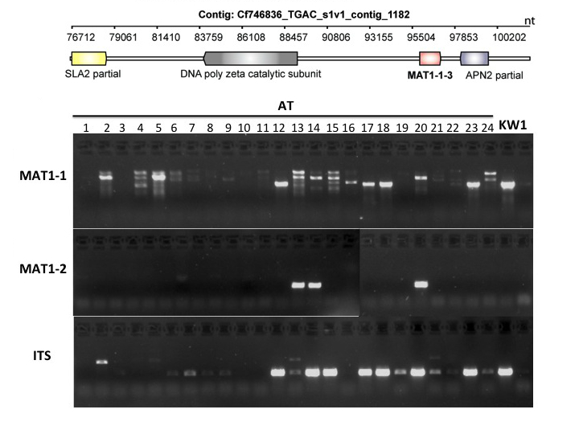
MORE THAN ONE MATING TYPE
Anne Edwards
Diane Saunders
-JIC
http://dx.doi.org/10.6084/m9.figshare.1005008
Notes:
We had analyses provided that used partial sequences of MAT loci, mating type loci from related species and used those to fully reconstruct the same in H.pseudoalbidus and then showed that different mating types were present in the UK and at a ratio that suggested sexual crossing had been going on for a while. Which in turn indicated the fungus had been in the country for longer than the first sightings.

Slide 20
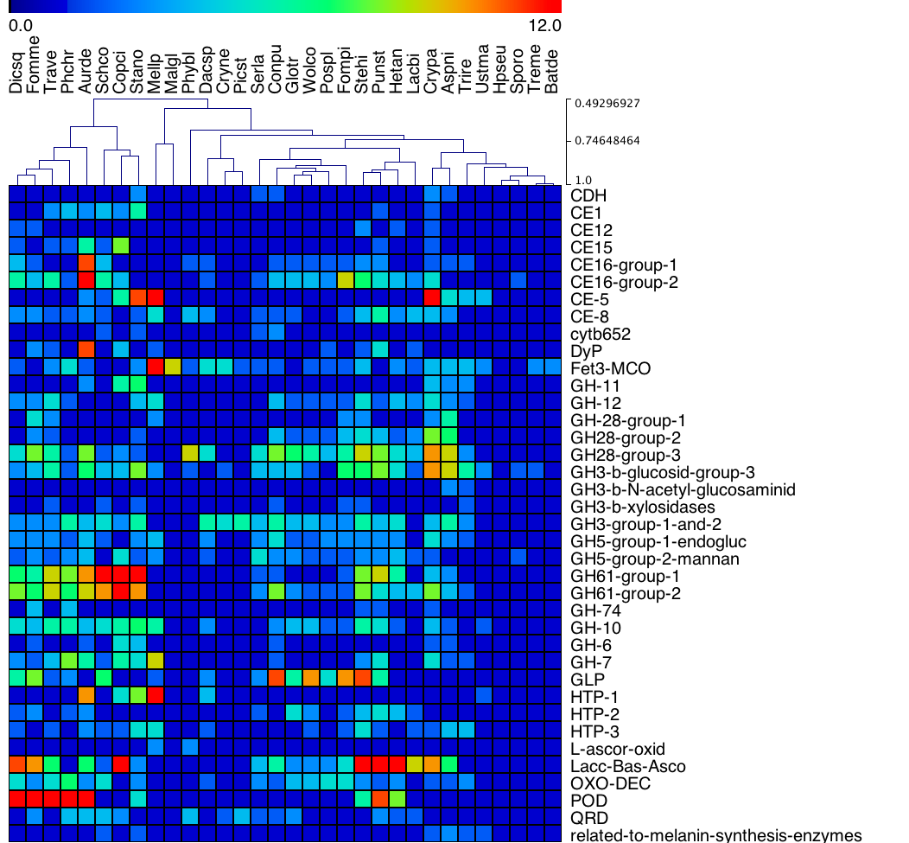
NOT A ROTTER
H.pseudoalbidus doesn’t have the genes for wood digestion
http://dx.doi.org/10.6084/m9.figshare.791635
Notes:
As it’s a tree pathogen we also inspected the genome for genes that are typically involved in lignin and cellulose degradation, the major components in wood.
The genome was compared with those from a load of basidiomycete wood rotters, and counts of typical degradation genes made, H.pseu pops up down at this end, with virtually none of the sorts of genes that are typically used in digesting wood, indicating that it gets into the tree without directly attacking the wood.

Slide 21
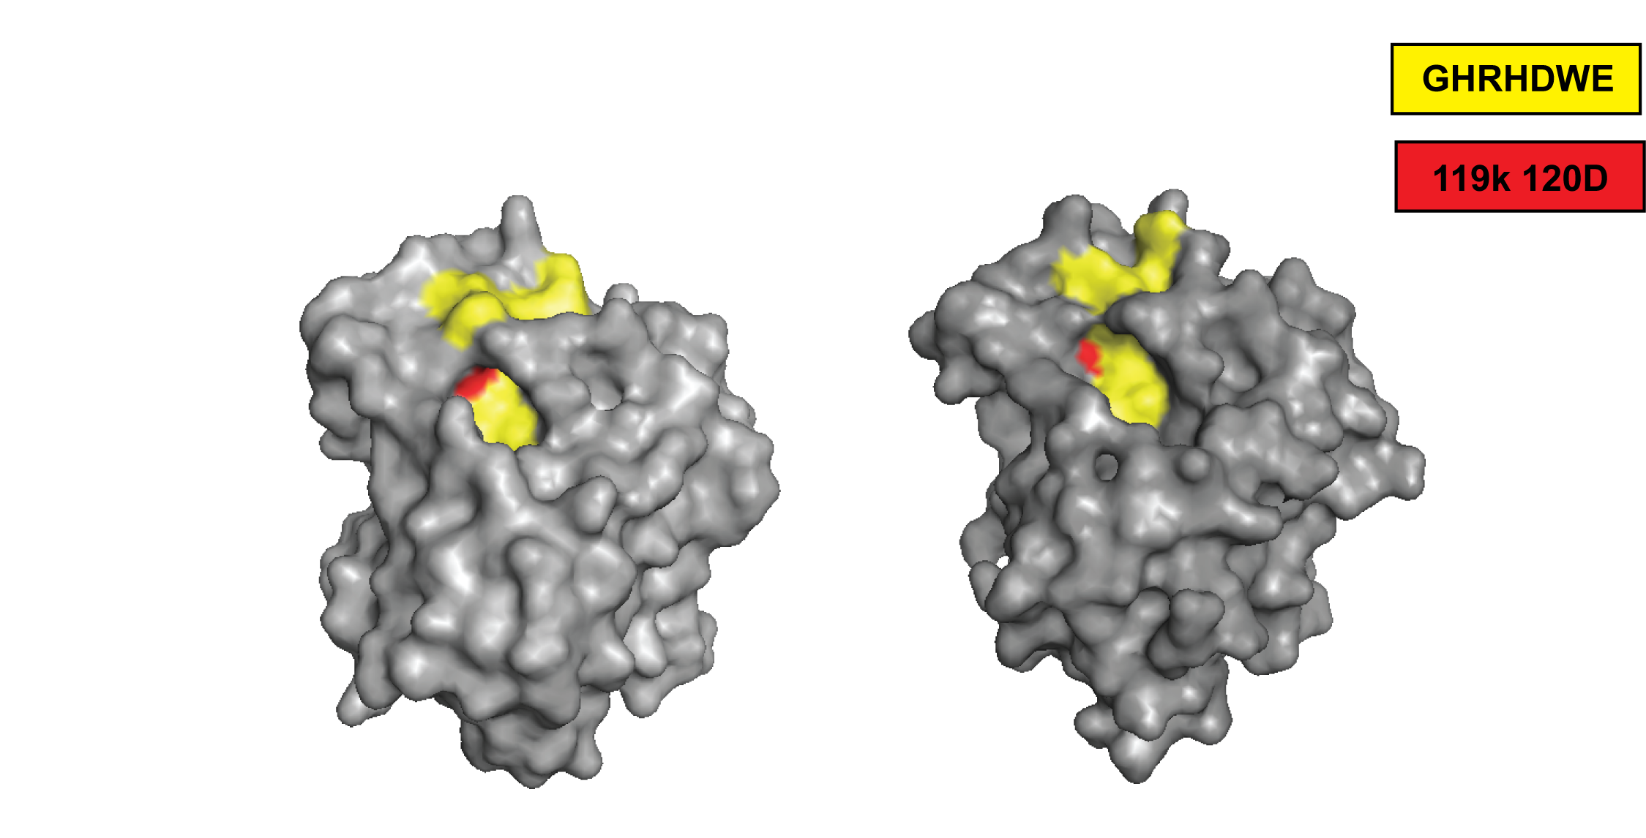
TOXINS ENCODED
Nep1-like protein in the genome
Suomeng Dong
H.pseudoalbidus hypothetical NLP
NLPpya 3GNU
http://dx.doi.org/10.6084/m9.figshare.1005010
Notes:
Suomeng collated seven fungal and oomycete Nep1-like protein (NLP) sequences from public databases and used these in a tblastn against the h.pseu transcript assemblies. He identified a transcript with high similarity to NLPs,
The protein sequence was then used for protein structure modelling, with the published NLPpya 3GNU as a template. This analysis shows that the predicted protein we identified carries all the key residues for NLP cytolytic function, these red ones here.

Slide 22
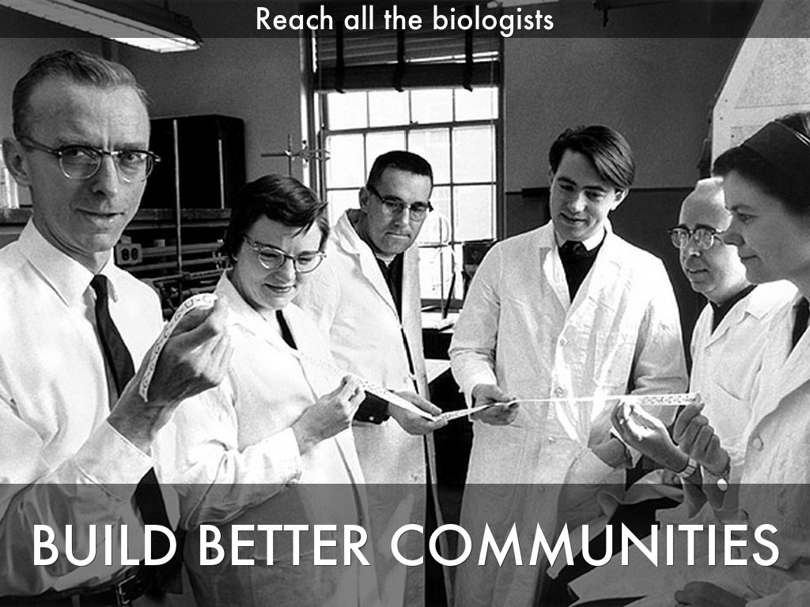
Photo by mars_discovery_district - Creative Commons Attribution-NonCommercial-ShareAlike License http://www.flickr.com/photos/17016583@N00
Created with Haiku Deck
Notes:
Getting bioinformaticians involved through github is fine.
But they have a habit of doing bioinformatics analysis and knowing less about the pathogen than they might
We realised that to really add value to our data then the important thing is to bring in biologists, who know all about the pathogen and host biology to get involved and liberate the genomics data and expertise to them and get the insights back from them.
The first thing we did was the same as every bioinformatician worth their salt, to put together the basic databases with the right query interface that will help the biologist find what they are looking for from their bit of sequence, their gene or protein function or their named gene and let them start to interrogate the data that was being created.
Crowdsourcing, and in particular wide ranging, comprehensive and hopefully sustainable crowdsourcing is dependent on the community that you can build. So the whole task generalises to one of how you actually build better biology/bioinformatics communities and how you incentivise that.

Slide 23
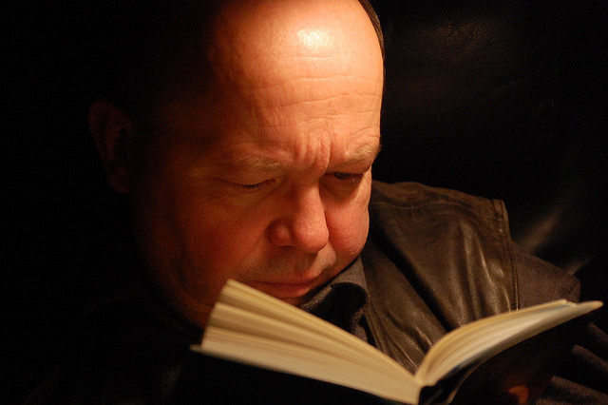
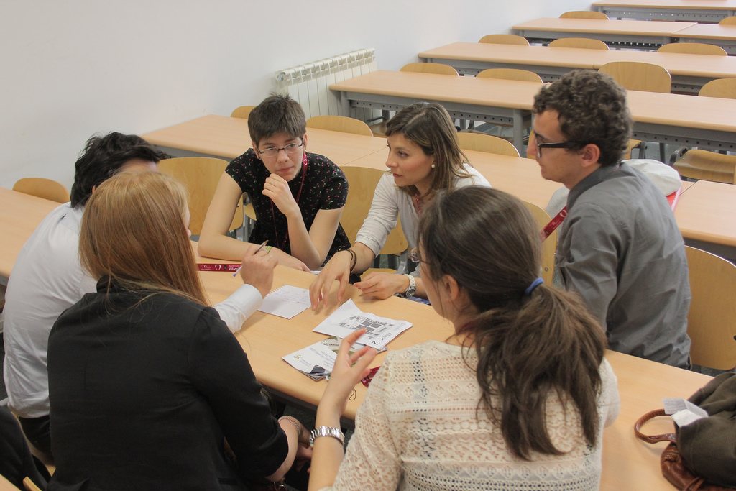
Watching tv versus playing a video game or
Reading quietly versus debating
CROWDSOURCING GENOME BROWSER
Reading by JanH on flickr, licensed under CC-BY-NC-SA 2.0
Discussion by Bestorg on flickr, licensed under CC-BY-NC 2.0
Notes:
And we’re trying this through new tools and interfaces.
We’ve put together something we’re calling a crowdsourcing genome-browser. Im sure that you’re familiar with the idea of a genome browser.
Our crowdsourcing browser relates to that in the same way that this guy reading his book relates to these people having a discussion. Our new crowdsourcing browser allows us to take in things like annotations, and experimental information straight into the repository while providing functionality like BLAST. The info is recorded piecemeal and reflected back to the other users of the tool directly.

Slide 24

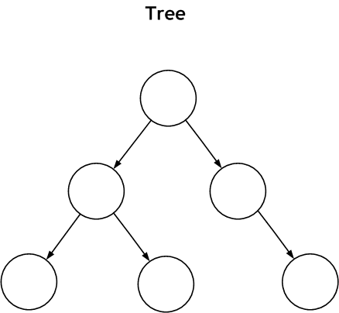
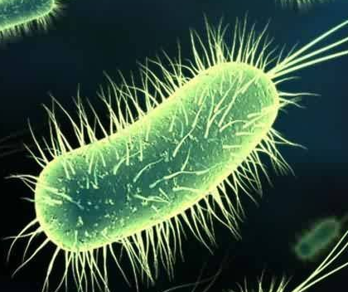

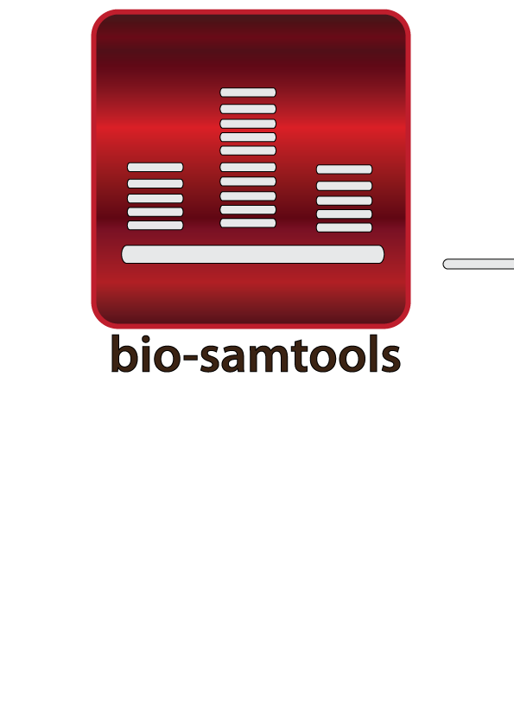
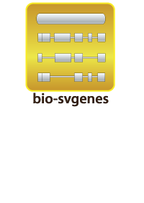
gee-fu – crowdsourcing genome browser
gee-fu – crowdsourcing genome browser
assemblies
annotations
https://github.com/wookoouk/gee_fu
doi:10.1093/bioinformatics/btr442
https://geefu.oadb.tsl.ac.uk
doi:10.1186/1751-0473-7-6
doi:10.1093/bioinformatics/btt294
Notes:
We’ve adapted an old lab tool that we used for collaborative annotation internally. Called Gee Fu and has genomic features as its main model and allows multiple organisms and multiple assemblies per organism to be called up and annotated, instead of just one.
It runs on our bio-samtools and svgenes gems to render bam data and features, and integrates other open source software like bio-dalliance as a portable viewport.

Slide 25
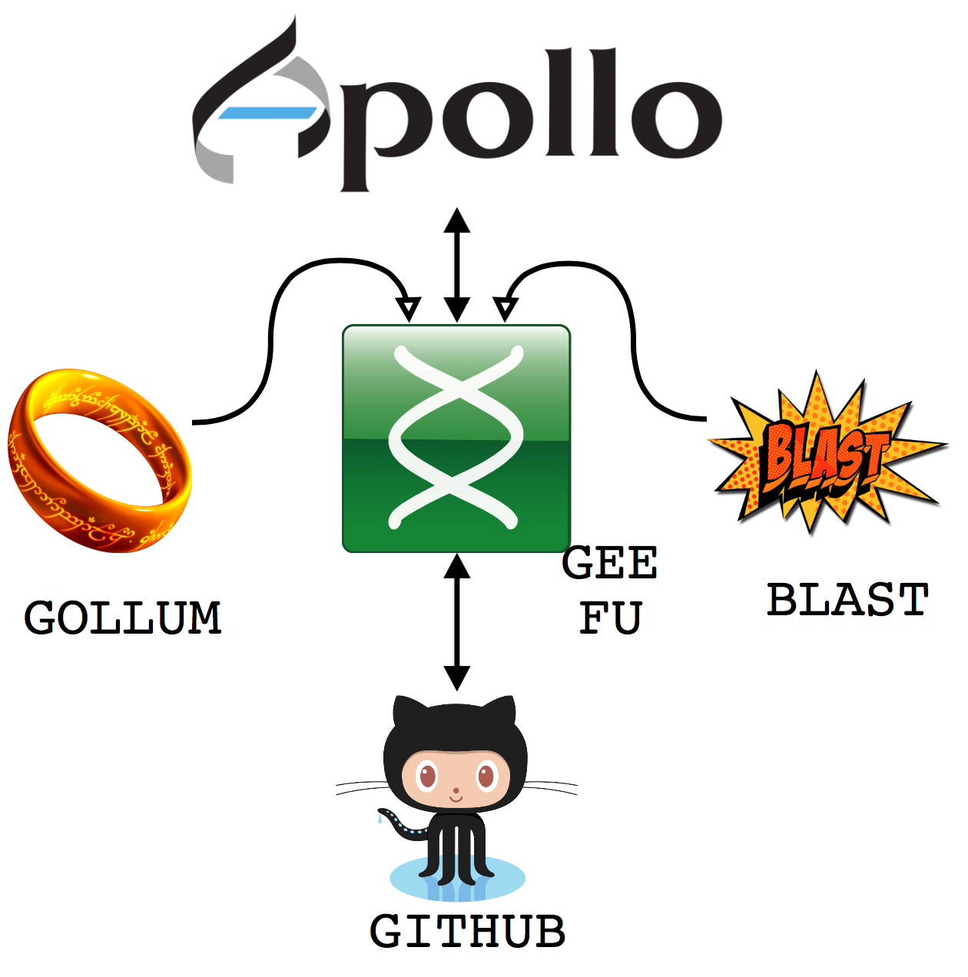

gee-fu – crowdsourcing genome browser
Notes:
We call our tool Gee Fu and this is the Software stack. Its based on common open source tools, the inimitable WebApollo being the major genome browser style component, GOLLUM is a git based wiki engine, every object, not just features can be annotated through this wiki, and we also used sequence-server, a ruby gem that implements a BLAST server for sequence based searches. All these are tied together through Gee fu, which is a piece of middleware that acts as an integration layer between other tools
it acts as the dispatch engine for data to the GMOD project web-Apollo genome annotation browser, as a feature linking engine for the wiki and as the sequence store for a BLAST server.
It coordinates automatic exchange and concurrency of data between the apps and the github repo, making sure that contributions from these other tools are tracked into the github repo
It provides a restful interface to the repo data and still acts as a feature and meta data editor in its own right.

Slide 26
gee fu – in browser annotation
Notes:
Its major function is annotation, the tool provides ways of directly editing and annotating gene models as you browse, and propogates all the edits directly to the data base so all other users can see immediately

Slide 27
gee fu – in browser analysis
Notes:
It also allows sequence searches of the provided data too, and fully cross links this back to the annotations and reports Kind of like a “build your own NCBI”, but restricted to a new and growing set of information for ash dieback

Slide 28
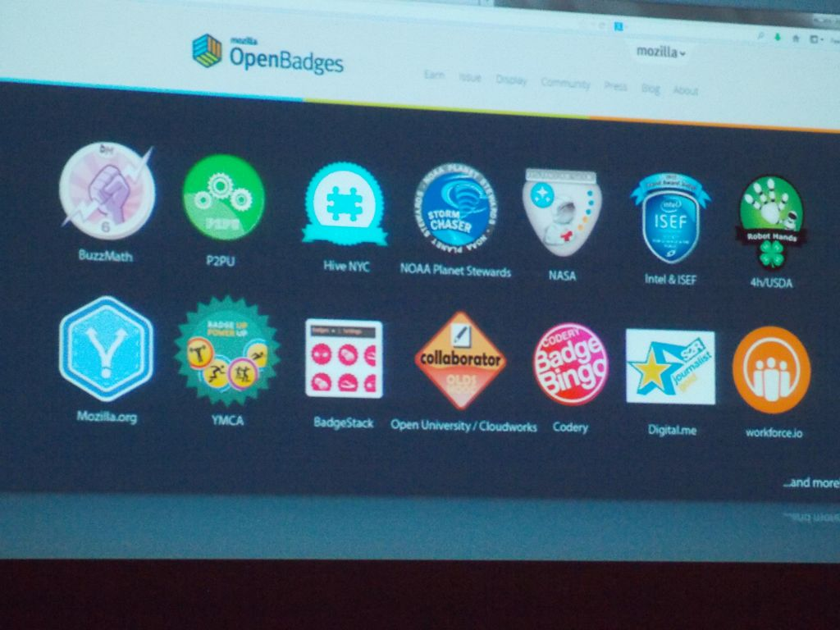
Photo by HASTAC-DML - Creative Commons Attribution-NonCommercial-ShareAlike License http://www.flickr.com/photos/29677268@N06
Created with Haiku Deck
Notes:
When it comes to getting micro-contributions back from individual specialists, then we have a very different problem. First of all, the biggest hurdle is the publish-or-perish imperative through science. As I’ve mentioned, scientists need publications. At the moment, pretty much the only recognised research output is the paper which is why people sit on their results for so long. But open science movements are pressing on and having some effect so there may be opportunities to start valuing much smaller bits of research.
So we’ve been implementing reward badges into our tool stack.

Slide 29




Mozilla OpenBadges
http://openbadges.org
certification of achievment
earn
issue
display
Notes:
Badges are tiny, virtual rewards for completing tasks, you’ll be familiar with them from all sorts of places, like Facebook or video games or even fitness apps on your smartphone.
Mozilla has a very flexible and useful open badges scheme.
As a contributor you’ll be able to earn these badges for accomplishment.
An issuer, then certifies the content of the accomplishment or skill you’ve attained so the conctributor
display a verified badge in a web portfolio and show off what you’ve done.

Slide 30
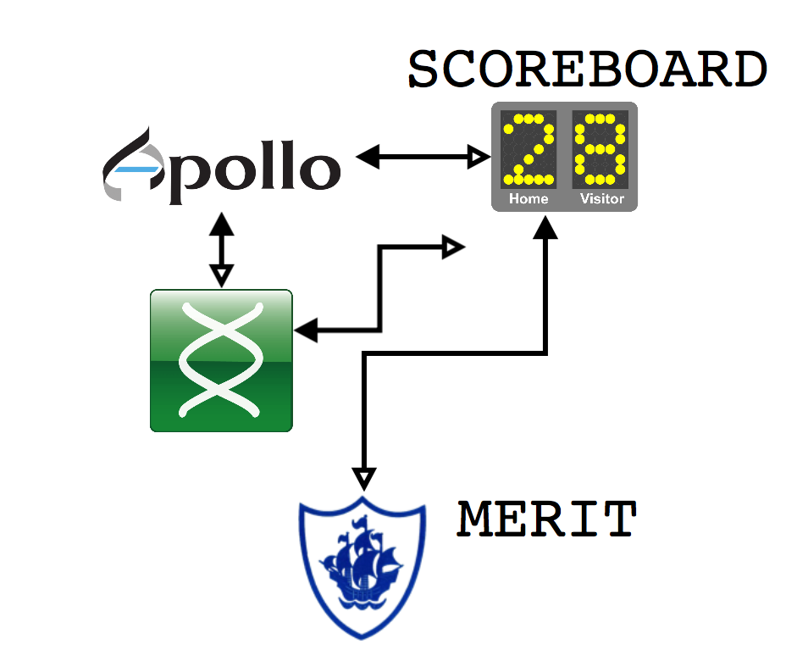
Notes:
So we added two very specific tools to our stack to manage badge awarding as contributors used the stack. The first of these is Merit, a standalone web app for managing badges themselves. And we also added scoreboard, a tool for tracking the activity of a user within the apps and issuing one of the badges in merit once the achievement has been reached.

Slide 31

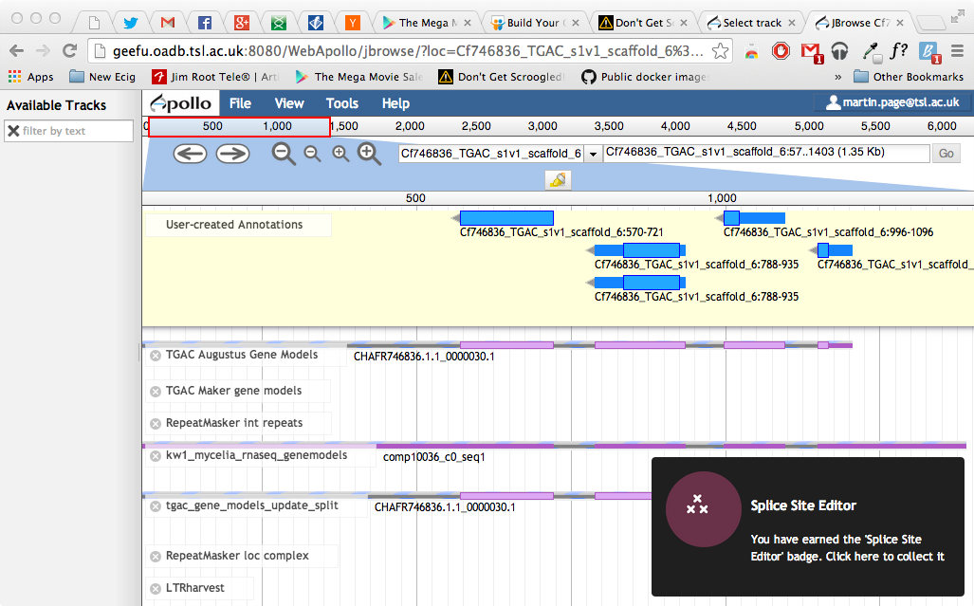
Feature Editor
You have earned the ‘Feature Editor’ badge, Click here to collect it
Notes:
The user is kept informed of progress by little pop ups as they work, click throughs allow the badge to be collected

Slide 32
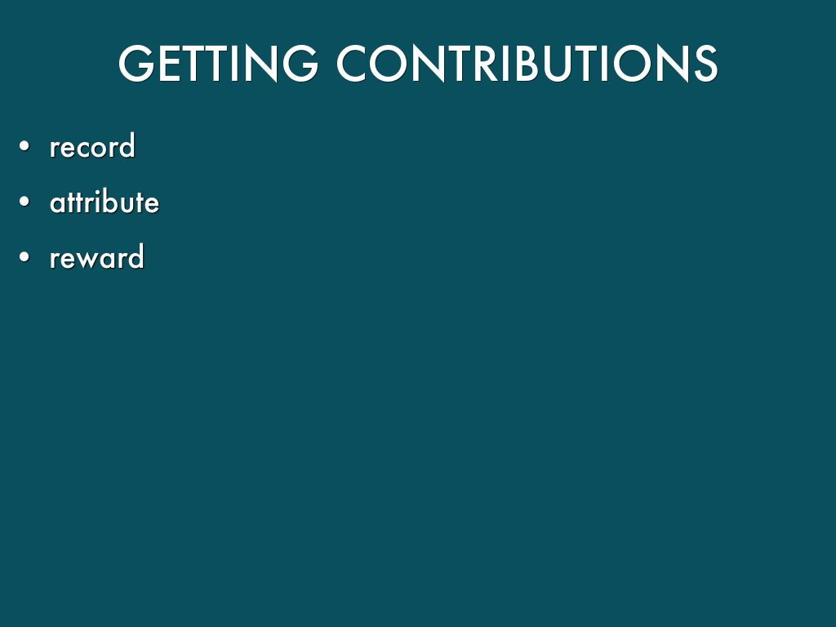
Notes:
When it comes to getting micro-contributions back from individual specialists,

Slide 33
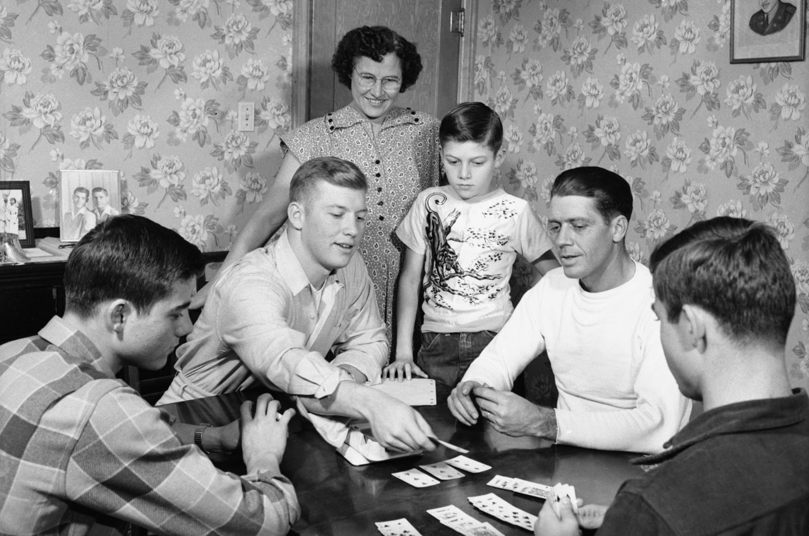
Humans love games
Notes:
And finally we hope to also be able to reach non-specialists in the general public, people with only a few minutes at a time to spare but a desire to help.
Scientists terribly outweighed in numbers by non-scientists, people with interest in these issues, who are motivated to use their spare (and not just professional or work time) to try and make a difference in the world.
So we’ve started crowd-sourcing through citizen science projects.
And we took the opportunity to use people power to do analysis of genetic variants that would show up in our sequence data
In many of the variants we want to examine, the computer programs make errors that a human being would not.
High throughput algorithms are error prone in some key parts of assemblies and genomes, like INDELs, or at assembly ends or repeat rich regions.
Scientists correct the alignments that underly SNP calls by eye all the time: So we built a game to allow Non scientists to do this for us and put the SNPs the computer is likely to have got wrong into it.

Slide 34

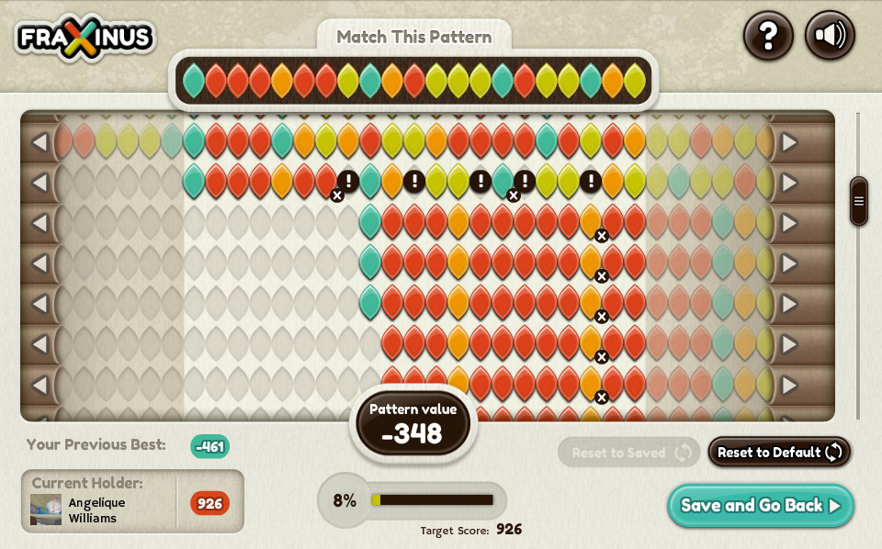

http://apps.facebook.com/fraxinus
Notes:
So the game we produced is called Fraxinus, it’s a FLASH only facebook game designed by myself and the BAFTA nominated game company Team Cooper in Sheffield
This is the main game screen of Fraxinus,
Along the top we have Target Pattern, from one of our references. Targets are pre-selected to be the sites the algorithms make a mess in.
The rest of the coloured rows are reads from DNA sequencing experiments.
The player can Shift, insert and delete nucleotides to make best alignement
Score for matches, score deducted for mismatches and creating and extending gaps.
Once player has maximum score they think they can get, they can claim the pattern for themselves and get points for that

Slide 35
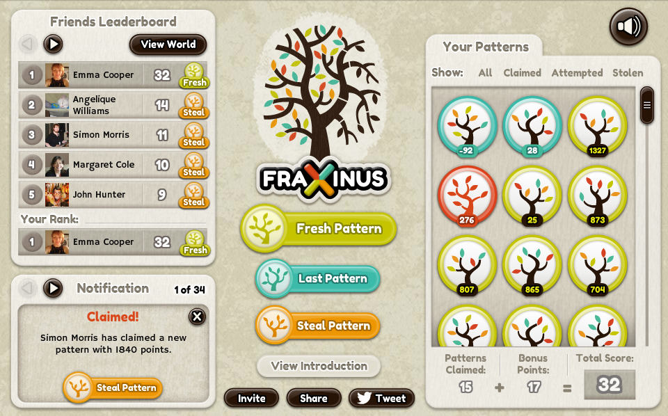
Notes:
Extra Value comes from being able to play against your facebook friends. The game allows you to compete directly over patterns. The box on the right contains the patterns you’ve won, but by hitting the steal patterns button you have the opportunity to take a pattern from a friend.
All you have to do is score one point more.
This is valuable to us, because then the patterns get analysed more deeply since many sets of eyes and brains look at each.
The game incentivises this behaviour by awarding more points for stealing than taking a fresh pattern. Thus the winning strategy requires the player to replicate an analysis.
The game takes the colour information from the alignment and returns a SAM format file to a MySQL database on our server along with the players FaceBook name.
We can take this data and put it straight into analysis pipelines.
So playing the game is doing real science. The results the players give us go straight back into our public databases to be used in further analyses.

Slide 36
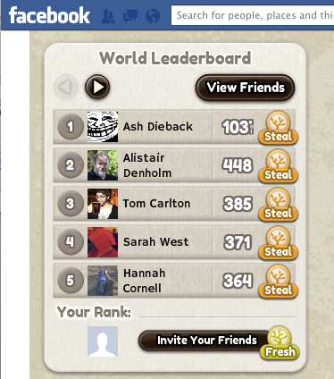
Lots of people are playing
In 6 months: 55K visits from ~25K players
Average visit ~23 minutes
2 years & 2 months - continuous game play
10K patterns – received 154K solutions
2000 players – 70% solutions
Notes:
We had some interest in this from the media, it was featured on the main BBC radio news programmes and the national news on TV.
As a consequence we have had a very fast and very high response.
25 thousand unique players in 126 different countries
With more than 100 playing simultaneously
First data set of 10 000 patterns done in just ten weeks.
About a third of the variants we added were improved on by the players. So this is a genuinely useful way of making use of the crowd of citizen scientists and we can start to push our results back into the repository.

Slide 37
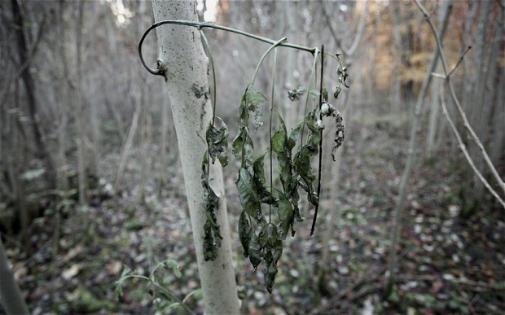
Notes:
In the end, our ability to deal with emergent pathogens, of trees, of crops or of people and animals depends really on how quickly we can start to understand them as scientists, the established way of doing this isn’t going to be enough in many cases.
Getting people to contribute depends on the magnitude of the problem but also relies on the credit we can give and the way that credit is recognized and that too is changing: Open science and open data are themselves emergent trends, biological science is opening up and taking advantage of every avenue it can, its turning the way it does things on its head. It is starting to come out of the woods.
In plant pathology we hope that our ash dieback project will not only provide us with insights into this specific emergent pathogen in a way we haven’t been able to do before but that it will help to inspire a wider take up of these methods.
And in this specific case, indeed this is what seems to be happening…

Slide 38










Nornex
An international ash dieback consortium
Notes:
Once our project had started rolling well enough, a large consortium, called Nornex raised itself into being. Made up of a large number of high-profile international partners, some in Norwich like us and already on board, such as TGAC and JIC, it also contains governmental bodies like Forest Research and Fera.
And the best thing is they’ve all agreed to play by open access rules so our project is only getting bigger and involving more types of scientist.

Slide 39

Crowdsourcing, a way to launch new projects
Discussion by Bestorg on flickr, licensed under CC-BY-NC 2.0
Notes:
So that in the end is the big pay off. Crowdsourcing can generate a new community with enough data and preliminary results to not only answer questions but prove to a funding body that a project is important and viable. It can also help bake in open-ness from the get go. Crowdsourcing can be a great way to launch new projects.

Slide 40



Acknowledgements
Martin Page
Graham Etherington
Sophien Kamoun
Kentaro Yoshida
Diane Saunders
Suomeng Dong
Joe Win
Daniel Bunting
Rachel Glover
David Studholme
Christine Sambles
Team Cooper
Thomas Down
everyone on oadb.tsl.ac.uk
All players of Fraxinus
Allan Downie
Anne Edwards
Mario Caccamo
Bernado Clavijo
David Swarbreck
Manuel Corpas
Notes:
So finally here are just a few acknowledgements, not everyone we’ve worked with at TSL
This is a list of people involved with the work I concentrated on in this talk.

Slide 41


More Info
http://tinyurl.com/dan-maclean
http://biorxiv.org/content/early/2014/04/25/004564

Slide 42
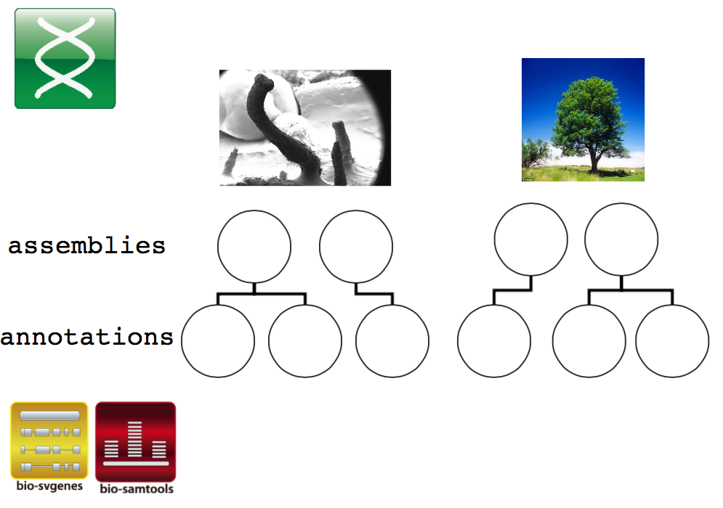
Notes:
GeeFu has one very interesting feature, it is adapted from an old lab tool that we used to use for collaborative annotation internally on multiple strains or isolates of different species, so while it has genomic features as its main model and it allows multiple organisms and multiple assemblies per organism to be called up and annotated, instead of just one.
This makes it possible and easy to have one unified interface for multiple strains or species and for the user to switch easily between them. It automatically manages the multiple versions of web apollo that are needed in this context.
It runs on some other bits of software we developed, like bio-samtools and svgenes ruby gems to access bam data and render features, and integrates other open source software like bio-dalliance as a portable viewport,
Together the stack allows us to provide data but also gives us a way to take in data while we’re at it, the geefu middleware provides a central way of maintaining attribution of contribution, it regularly and automatically moves data into and from the github repo from the other tools, keeping track of who provided what.

Slide 43



Extended crowdsource infrastructure
Annotation web-tools
BLAST
(sequenceserver.com)
OADB
Notes:
In our current project Gee fu sits as an integration layer between other tools more suited to specific purposes,
it acts as the dispatch engine for data to the GMOD project web-appollo genome annotation browser, as a feature linking engine for a wiki and as the sequence store for a BLAST server.
It coordinates automatic exchange and concurrency of data between the apps and the github repo, making sure that contributions from these other tools are tracked into the github repo
It provides a restful interface to the repo data and still acts as a feature and meta data editor in its own right. It
The key thing is that it provides a central way of maintaining attribution of contribution, it regularly and automatically moves data into and from the github repo from the other tools, keeping track of who provided what.

Slide 44
Mozilla OpenBadges
http://openbadges.org
certification of achievment
earn
issue
display
Notes:
Badges are tiny, virtual rewards for completing tasks, you’ll be familiar with them from all sorts of places, like Facebook or video games or even fitness apps on your smartphone.
Mozilla has a very flexible and useful open badges scheme.
As a contributor you’ll be able to earn these badges for accomplishment.
An issuer, then certifies the content of the accomplishment or skill you’ve attained so the conctributor
display a verified badge in a web portfolio and show off what you’ve done.

